Slide 1

Simulation of Concrete Cracking Pattern and Residual Mechanical Properties for ASR and DEF Expansion
YUSHI MENG
Supervisor: Dr. Kohei Nagai
Supervisor: Dr. Yuya Sakai
Notes:
0:00-0:15 15sec
Today I’m going to talk about my research
about
Simulation of Concrete Cracking Pattern and Residual Mechanical Properties for ASR and DEF Expansion

Slide 2


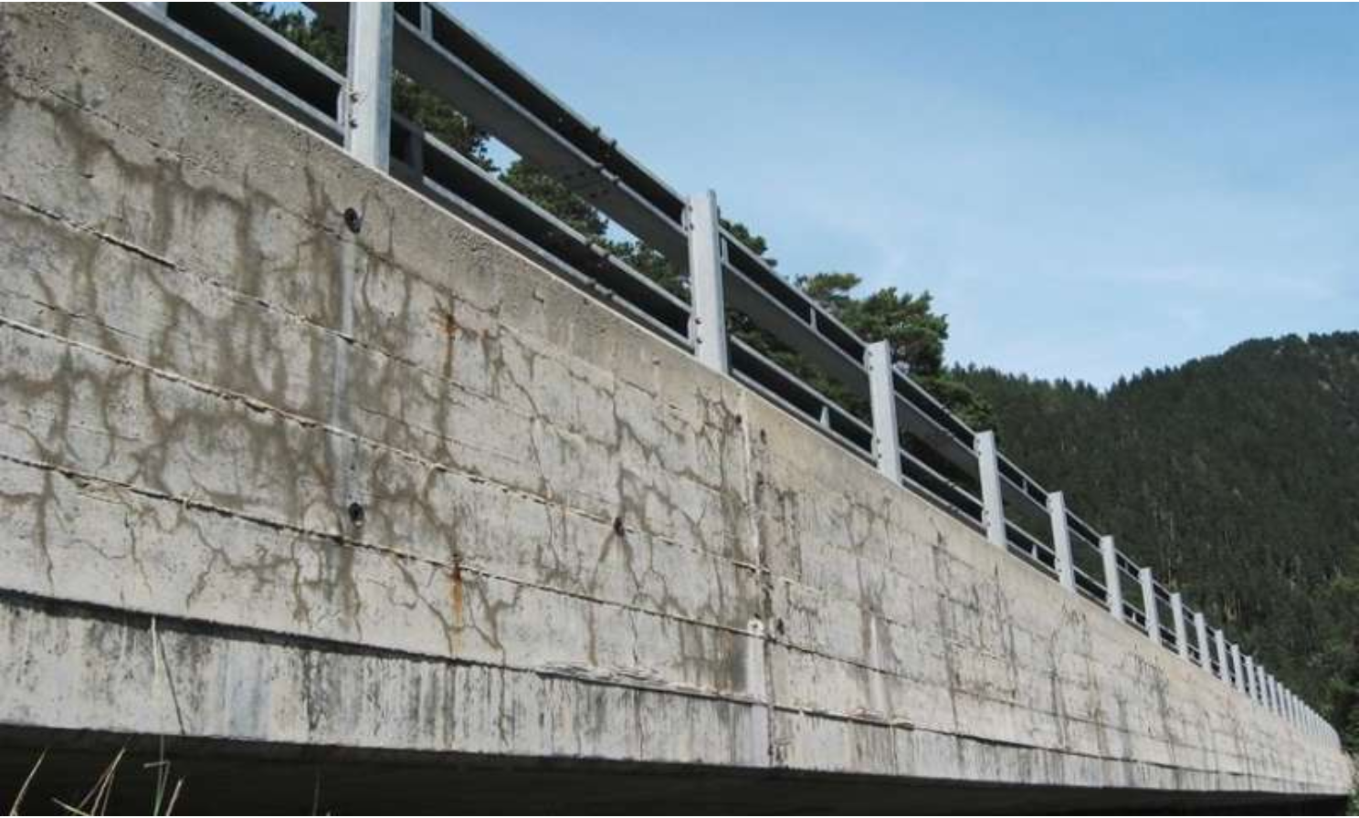
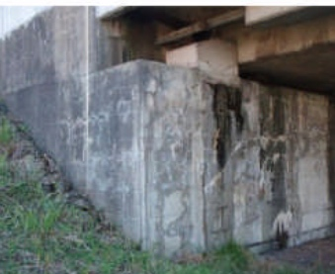
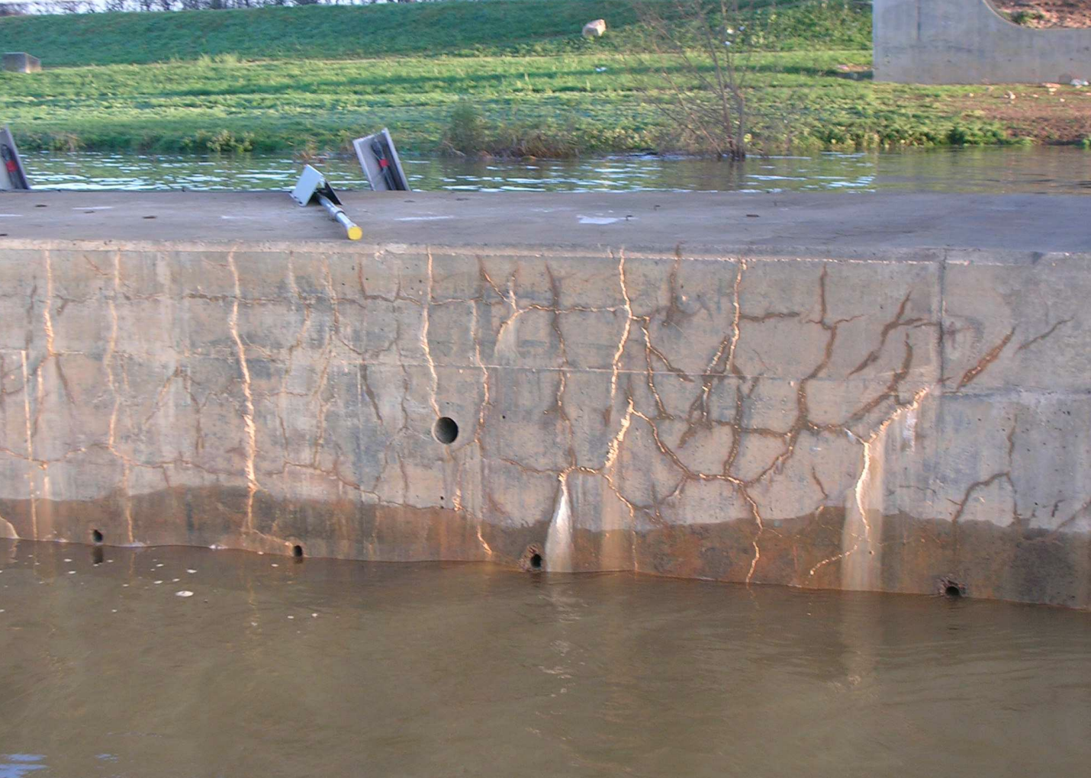
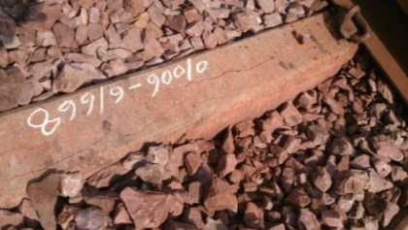
BACKGROUND
ALKALI-SILICA REACTION
DELAYED ETTRIGITE FORMATION
SWEDEN
USA
JAPAN
FRANCE
INDIAN
Cracking
Similar
Characteristic
Map Cracking Pattern
ASR
DEF
Loss in Capacity
Safety Concern
Two Main Reason Causing Expansion and Safety Concern
1
Notes:
00:15-00:45 30sec
ASR and DEF, are two common reasons of concrete expansion,
actually causing us a lot of concerns
(CLICK)
For example, the ASR damage reported in Japan and Sweden
(CLICK)
And severe DEF reported in Indian, France and USA
(CLICK)
These two expansion, with similar cracking pattern
(CLICK)
Damage the residual capacity of structures,
Finally become a safety issue.
00:45

Slide 3
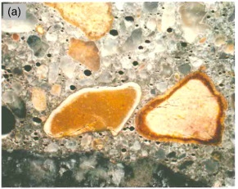
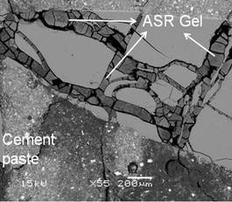
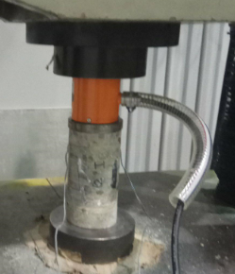
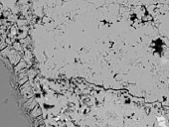
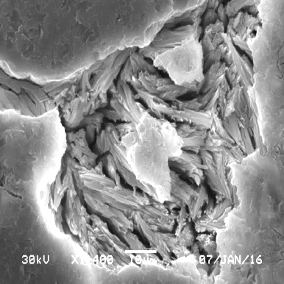
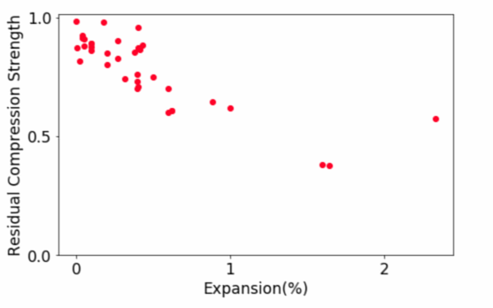
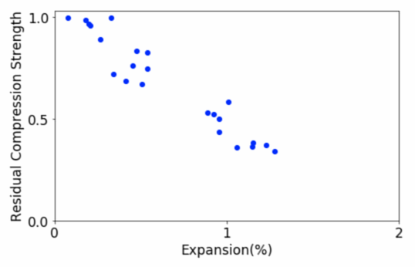
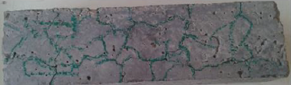
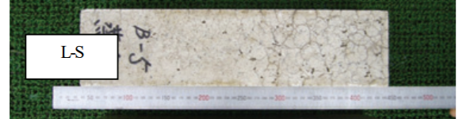
BACKGROUND
ASR
Residual Compressive Strength
Paste
Alkali–
Silica
Reaction
Experimental
Compressive Strength
vs
Final Global Expansion
Aggregate
ASR GEL
100%
100%
DEF
ASR
DEF
Delayed Ettringite Formation
50%
50%
EXPANSION
41%
EXPANSION
Paste
1%
2%
34%
1%
2%
ETTRINGITE
Relationship with Expansion Ratio Only
Similar Characteristic Map Cracking Pattern
Specimen of ASR expanded concrete, ALKANA, 2012
ASR
100mm
DEF
100mm
Specimen of DEF expanded concrete, KAWABATA et al., 2011
400mm
400mm
How Does Inner Cracking Behavior Influence Mechanical Properties?
2
Notes:
00:45-01:30 45sec
Though ASR and DEF both cause increasing in volume,
Their mechanisms are actually different.
Alkali silica reaction, introduce expansion by generate gel between mortar and ASR reactive aggregate
While Delayed Ettringite Formation Expanded in the paste
(CLICK)
Their Cracking Patterns are actually pretty close
(CLICK)
And can both lead to different level of Reduction in Mechanical properties
(CLICK)
As experiments of ASR and DEF can take years, and the difficulties to analysis these two complicated expansion behavior quantitively,
Here we use simulation to →
01:30

Slide 4
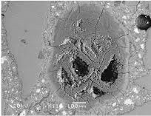
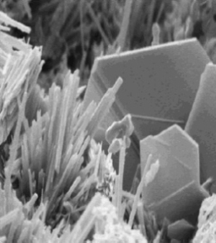
BACKGROUND
High Curing Temperature Delayed Ettringite Formation
Ettringite Formatted after Harden
Between Mortar vs. Mortar
ASR
OH⁻
of Alkali in Cement
Siliceous from Aggregate
Alkali-Silica
Gel
C-S-H GEL
Alkali–Silica Reaction
DEF
Primary ettringite
Primary
Ettringite
C₃A + Gypsum
Water
Water
Ettringite
Monosulfo-aluminate
C3A
Delayed Ettringite Formation
Primary Ettringite is good for the concrete
Delayed Ettringite
T>70°C
Decomposition of
Primary Ettringite
Moist
Concrete
Reformation of Ettringite
Delayed ettringite causes deleterious expansion
Steel Constrain
Boundary Condition
Structural
Behavior
ASR
+
DEF
+
+
ASR and DEF, Combined with Steel Constrain and Boundary Condition,
Influenced the behavior of concrete
Notes:
0:15

Slide 5
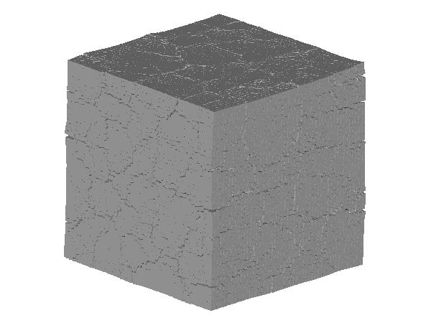
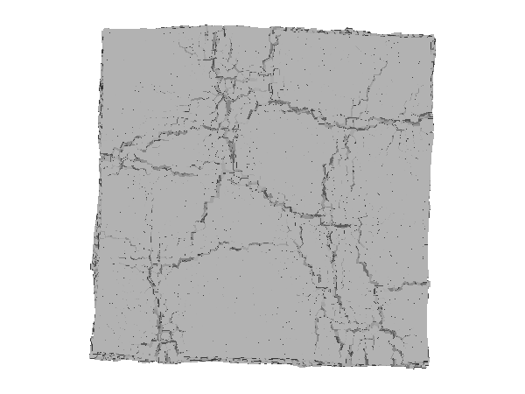
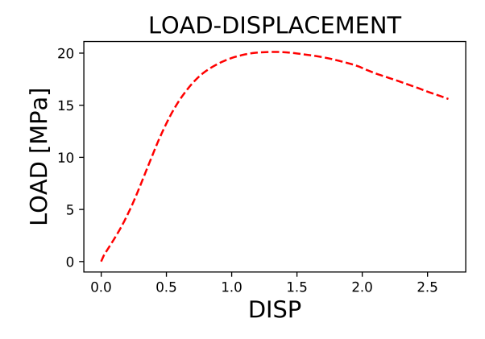
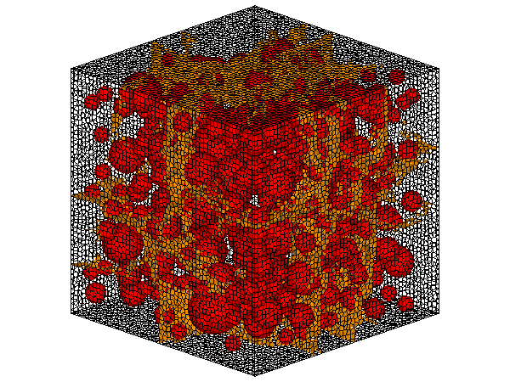
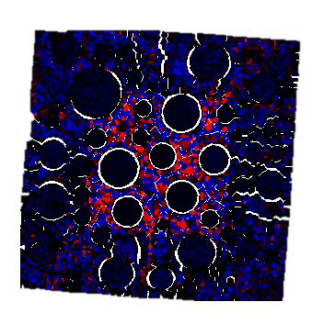
OBJECTIVE
Change in Mechanical Properties Due To Expansion
Residual
Mechanical
Properties
Expansion
Mechanism
Expansion
Behavior
Different Expanding
Interfaces
Confirming Expanding Behaviors by Different Expanding Mechanisms
Confirm Losses in Mechanical Properties
Paste
Volume
Increase
Surface
Crack
LOAD-DISPLACEMENT
ASR
LOAD[MPa]
Agg.
or
Compressive
Strength
DISPLACEMENT[mm]
Inner
Crack
Inner Stress
Paste
DEF
Relate Inner Expansion Behavior with Residual Mechanical Properties
3
Notes:
01:30-01:55 25sec
Represent the ASR and DEF Expansion behavior separately
by their Mechanisms,
Analysis their volume increase, surface cracking, inner cracking and inner stress condition,
Then simulate their reaction under Loading ----
obtain residual mechanical properties after expansion.
Finally may help us evaluating structures // in use.
01:55

Slide 6
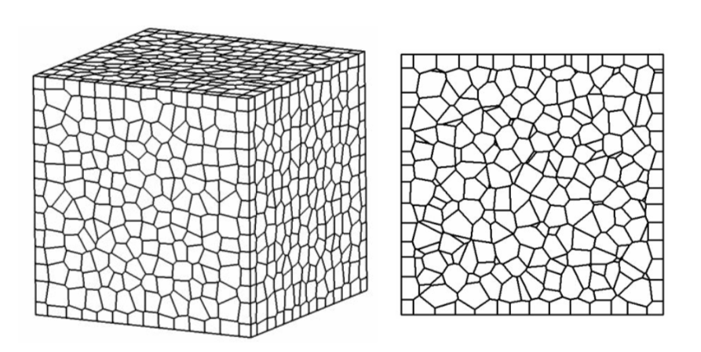
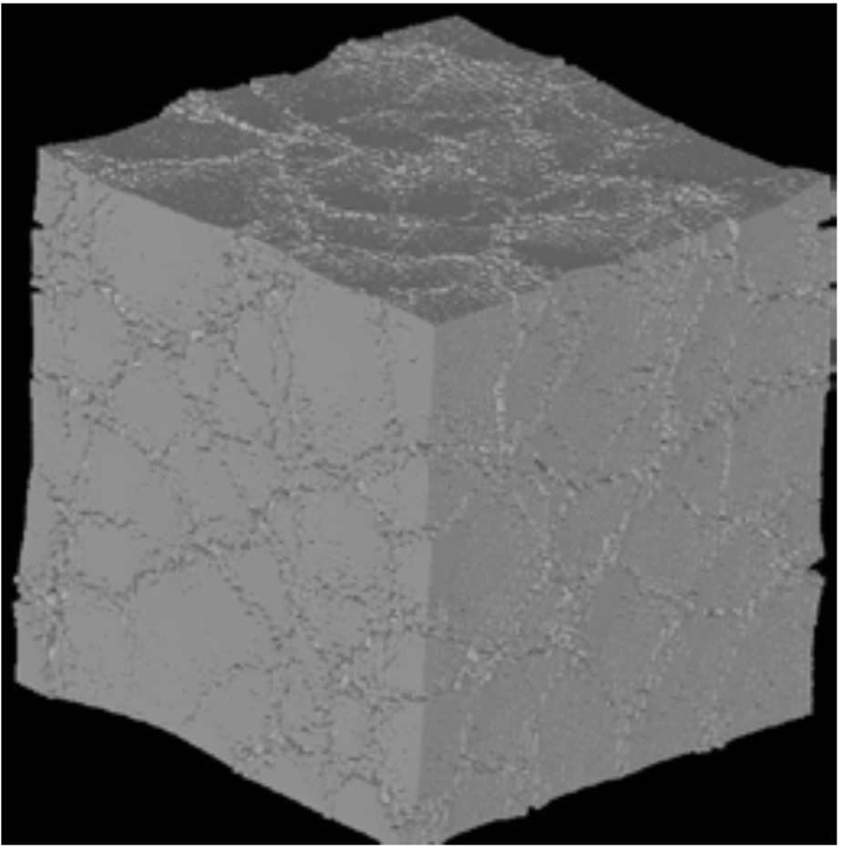
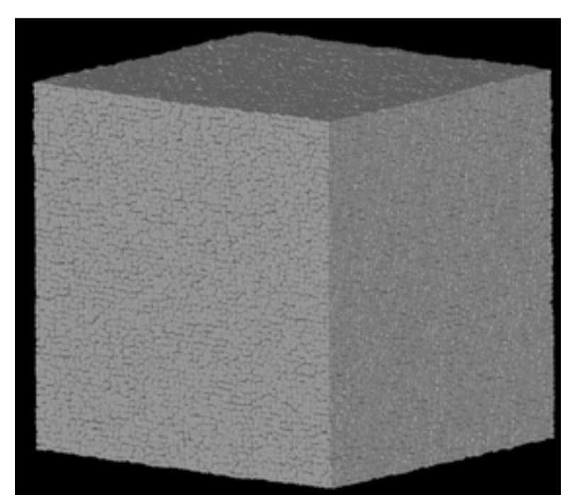
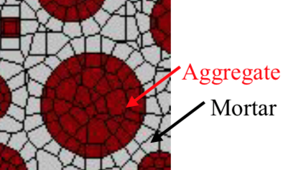
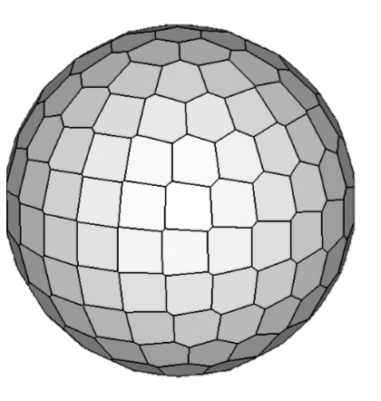
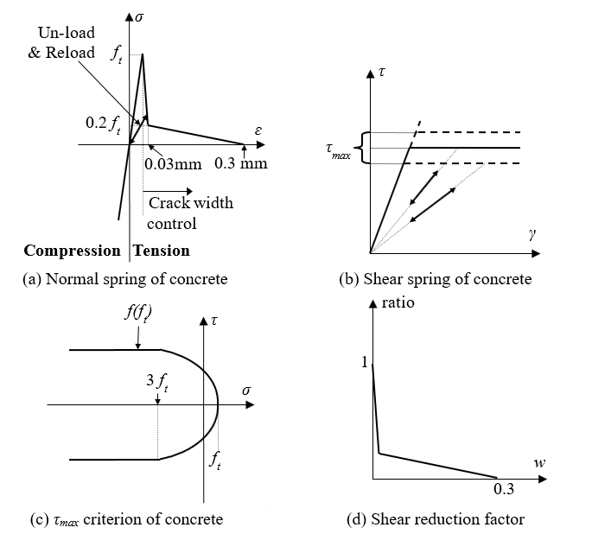
METHODOLOGY
Rigid Body Spring Model
Previous Apply in Concrete Expansion
ASR
DEF
No
Large
Crack
Map
Crack
Material Scale
Aggregate
Mortar
Micro Scale Element Behavior
Rigid Body
Element 1
Constitutive Model
Elasto Plastic Model
Rigid Body
Element 2
3 DEGREE OF
FREEDOM
1 NORMAL SPRING
2 SHEAR SPRINGS
Normal Spring
Shear Spring
RBSM is Appropriate Expansion and Residual Capacity Simulation
4
Notes:
01:55-02:30 35sec
For this, Rigid Body Spring Model is an appropriate method.
Cause it can model aggregate and paste element separately,
Directly formulate their behavior during expansion.
In previous research, done by Doctor Eddy
RBSM can successfully simulate map cracking pattern for ASR$
Here we'll improve this method for DEF,
And analysis on Mechanical properties losses for both the cases.
02:30

Slide 7
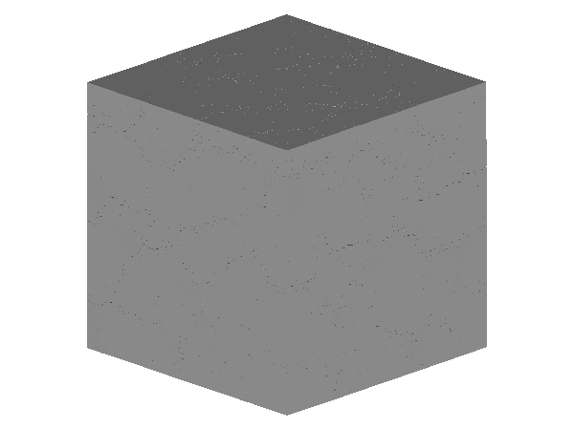
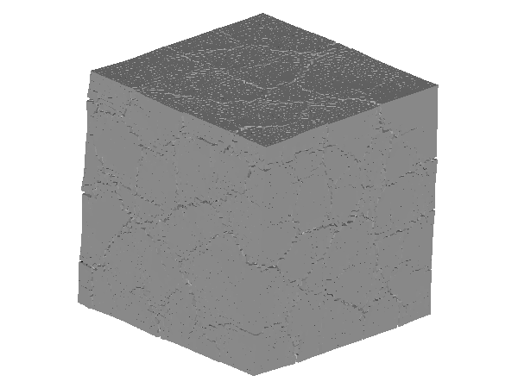

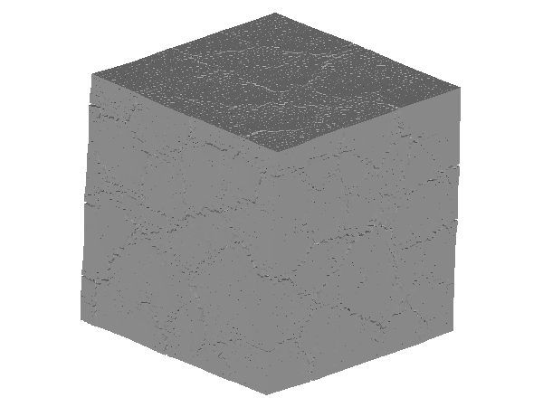
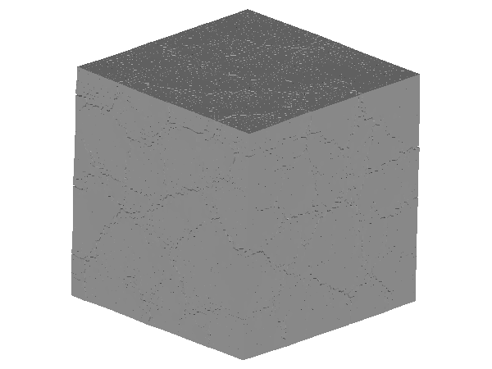
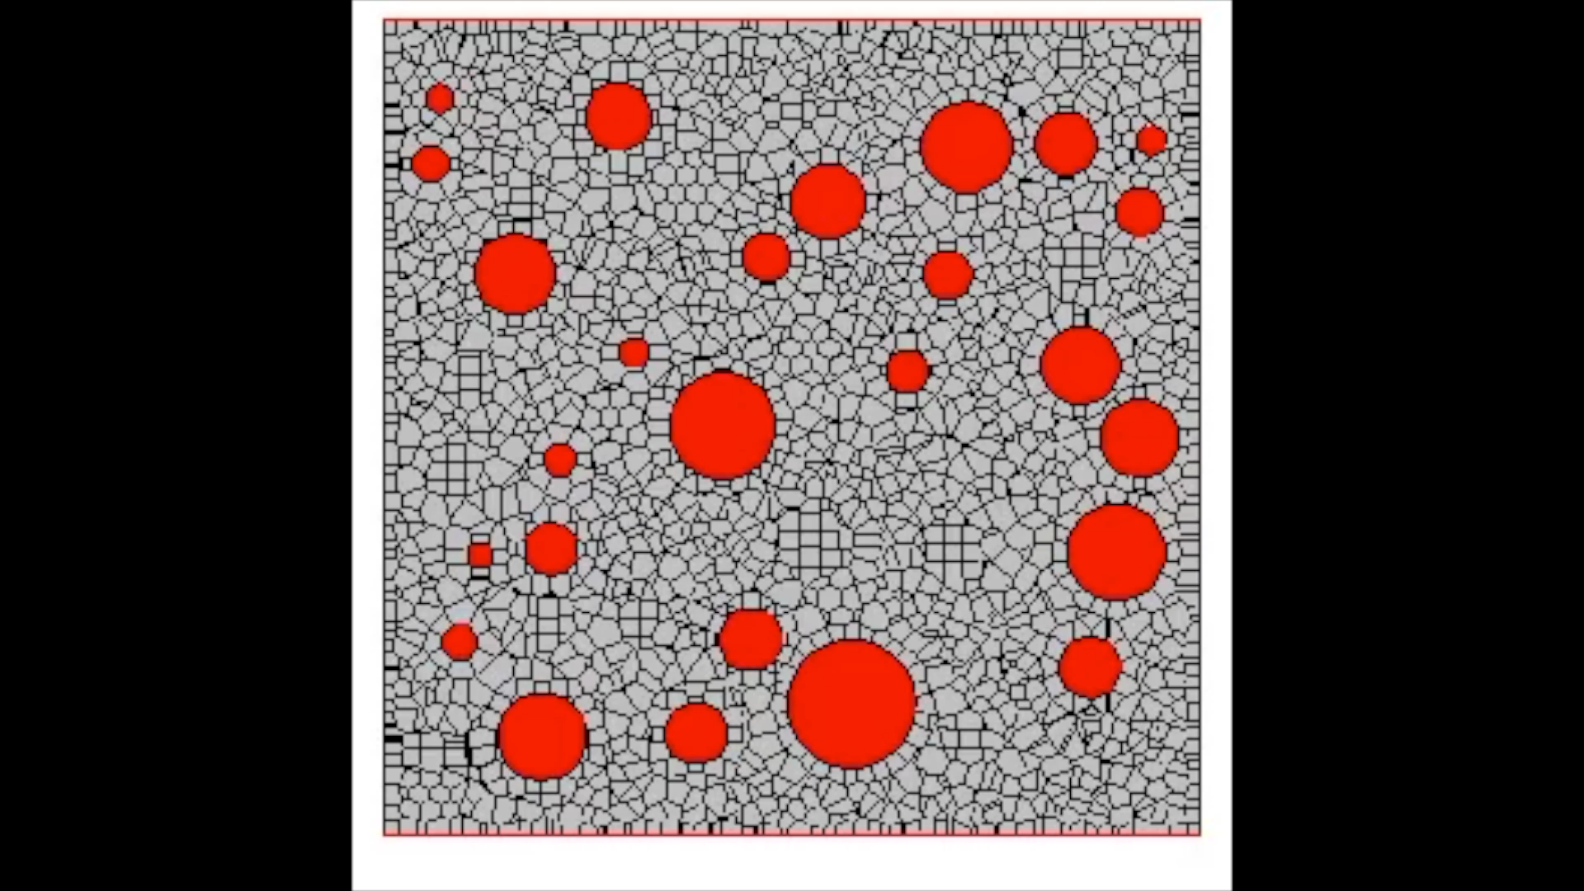
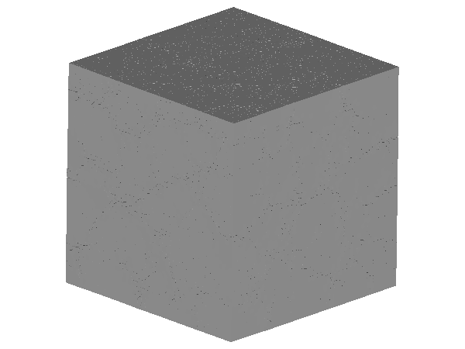
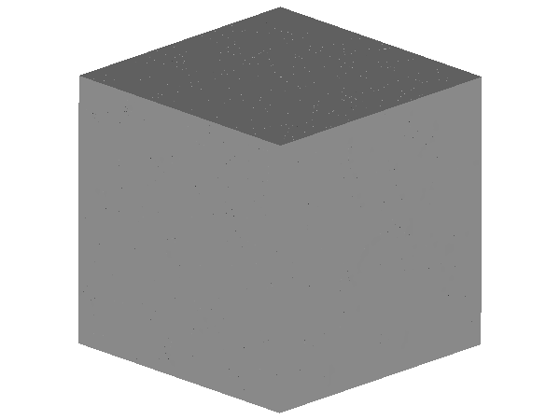

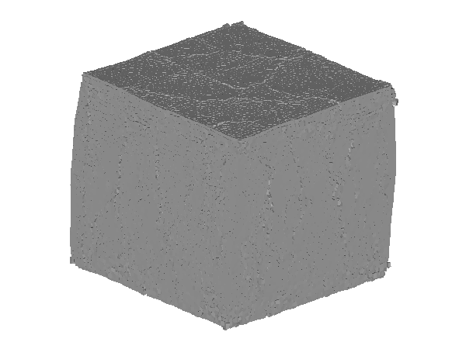
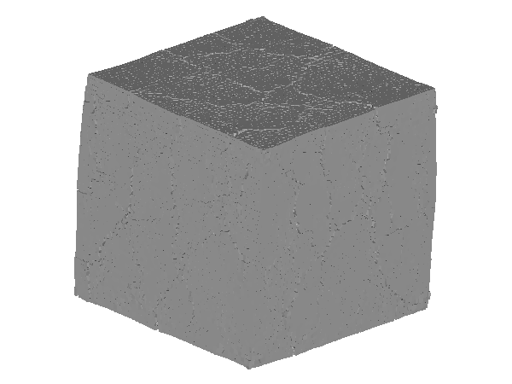
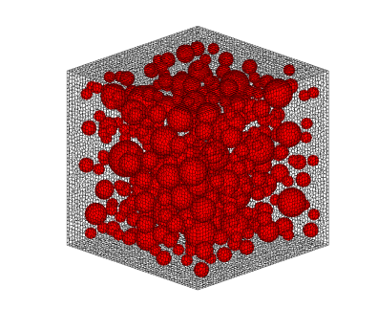
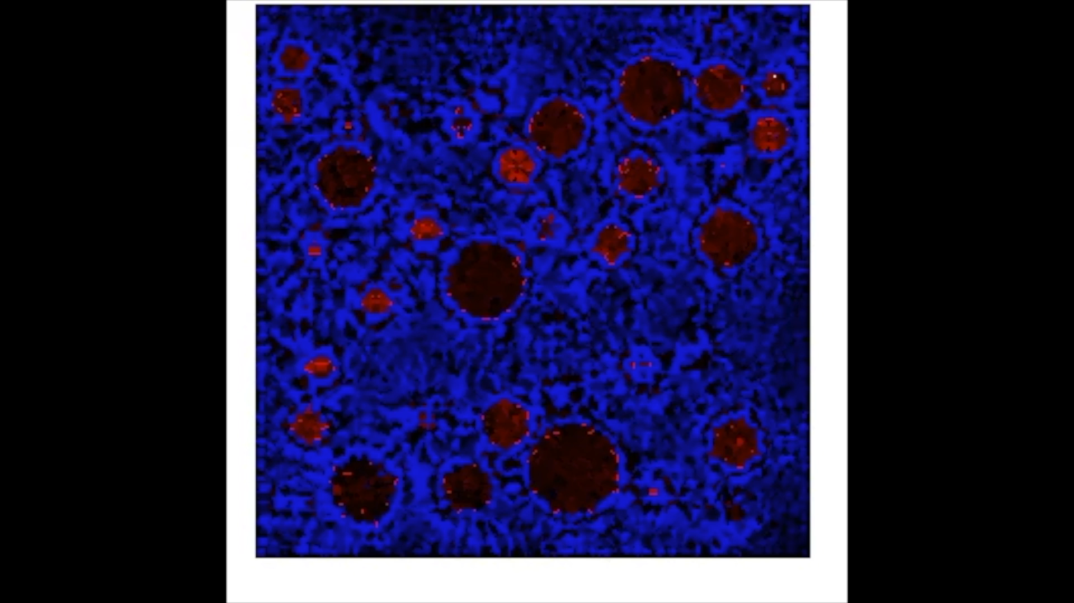
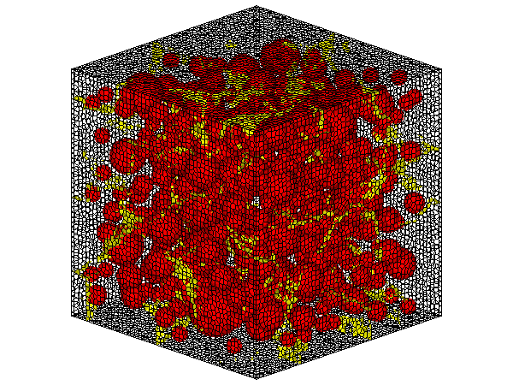
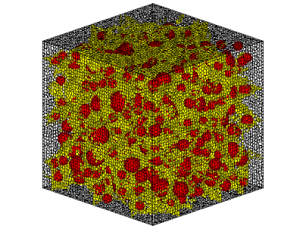
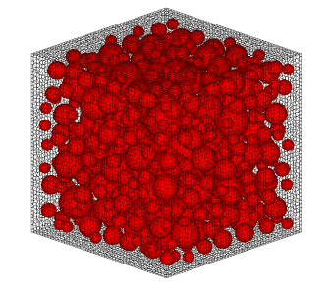
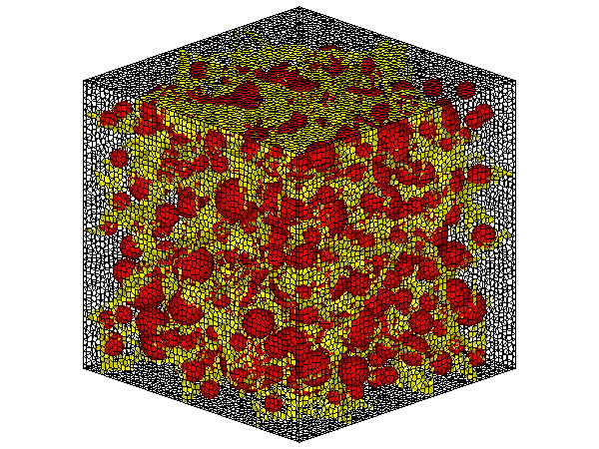
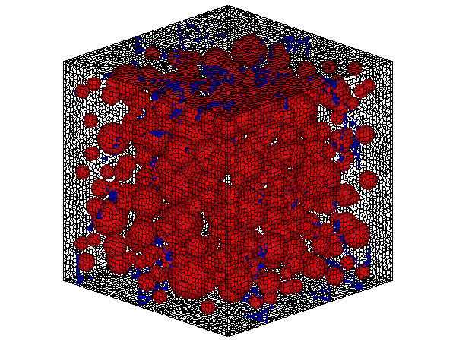
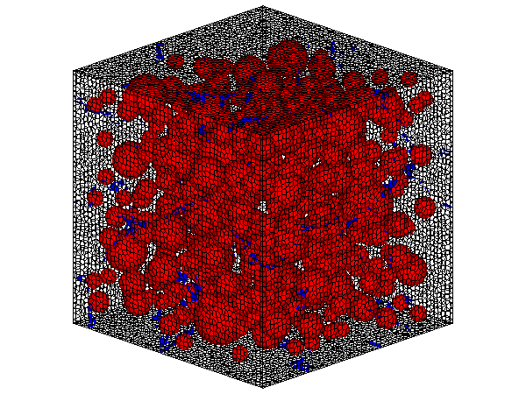
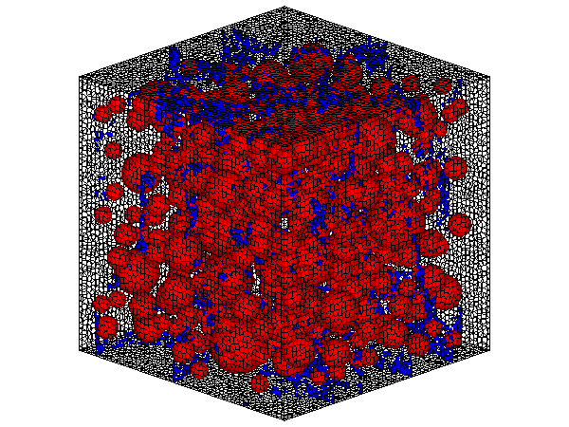

SIMULATION FLOW
MODELING
EXPANDING
LOADING
100mm
100mm
0.1%
0.3%
0.6%
14MPa
20MPa
0%
17MPa
100mm
1%
ASR
DEF
Number Of Element: 122374
Aggregate
20MPa
Aggregate
Mortar
17MPa
Mortar
14MPa
Mortar
Mortar
Obtain Cracking Pattern, Inner Stress and Compressive Strength
5
Front view
Front view
Notes:
02:30-03:10 40 sec
Here I’ll introduce how our simulation is working.
First, we build 3D model, adding coarse aggregate, and mesh the whole structure into randomized elements.
(CLICK)
Then, the expansion is applied,
For ASR, initial strain is given between ASR reactive aggregate and paste elements,
While for DEF, initial strain is given between paste and paste element
(CLICK)
Finally, we go into the uni-axial compressing test, with fixed boundary condition,
compressive strength at each step will be recorded.
03:10

Slide 8
EXPANSION RESULT
Notes:
03:10-03:15 5sec
First, Expansion Result

Slide 9
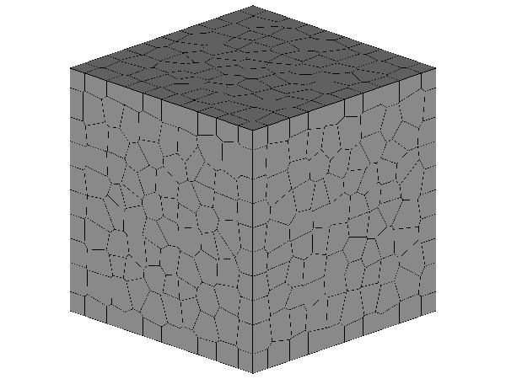
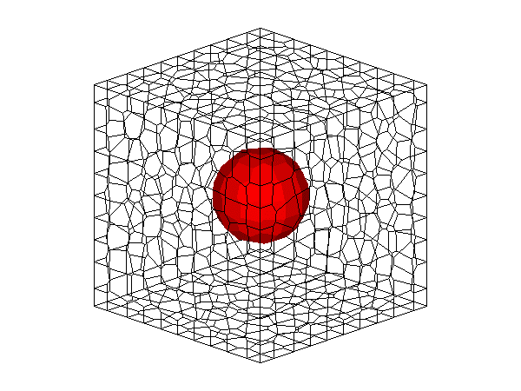
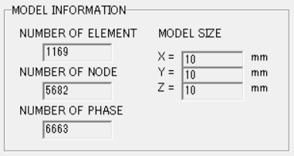
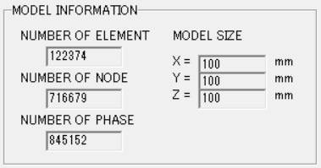
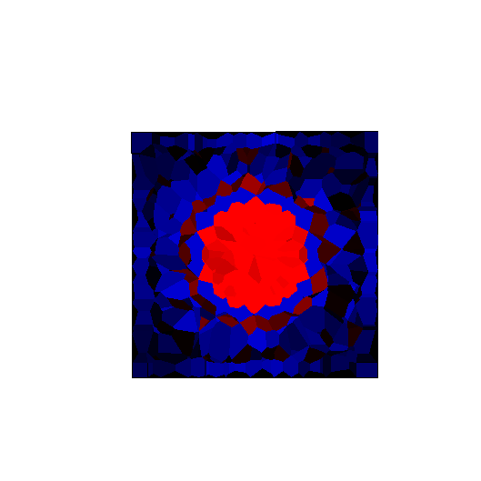
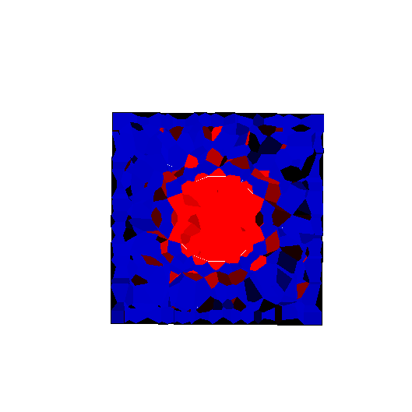








SIMPLIFIED MODEL
Single Aggregate Model
10mm
Number Of Element: 1169
10mm
10mm
Tension
Compression
ASR EXPANDING
3MPa
10MPa
Compression
* ASR EXPANSION: 0.01 strain/step
Paste
Radial Pattern Crack
Agg.
Initial strain
0.001/step
Confinement Force
Step 1
Step 15
Step 20
Step 5
Step 10
DEF EXPANDING
ASR GEL
* DEF EXPANSION: 0.003 strain/step
Paste
Uniform
Expanse
Initial strain
0.0003/step
Not Under Stressed
Step 20
Confinement Force
Step 1
Step 5
Step 10
Step 15
Different Internal Stress Condition in ASR and DEF Expansion
6
Notes:
03:15-04:05 50 sec
In this page ,expansion using simplified 10x10x10mm single aggregate model is presented.
Using simplified model we can better analysis the inner stress and crack development during expansion due to different mechanisms.
(CLICK)
For ASR,
As Initial Strain is given between aggregate and surrounding paste element, aggregate is under compressive condition by confinement of surrounding paste.
Radial pattern cracking start to generate from aggregate with deformation.
For DEF,
Initial Strain is given among paste element, so aggregate here is not under stressed, while the cracking generated is relatively uniformed.
04:05

Slide 10





ASR EXPANSION RESULT
Total Coarse Aggregate Percentage
ASR Reactive Coarse Agg. Percentage
Final
Expansion
Result
Surface
Cracking
Pattern
~30mm
25%
100mm
ASR Reactive
Non-Reactive
~0.4% EXPANSION
*FRONT SIDE VIEW
100mm
100mm
Totally 30%
Coarse Aggregate
~15mm
75%
~0.4% EXPANSION
*FRONT SIDE VIEW
Characteristic Map Cracking Pattern is Well Simulated
7
Notes:
04:05-4:35 30 sec
From here I’m showing our simulation result in full scale specimens, size in 100 by 100 by 100 mm
Firstly, ASR Expansion
(CLICK)
With 30% percent Aggregate, among them 25% are ASR reactive,
map cracking pattern is simulated
(CLICK)
And if we increase the Reactive aggregate to 75%, its expansion behavior also changed.
04:35

Slide 11



ASR EXPANSION RESULT
30% Aggregate
25% ASR Reactive
Map Cracking
From Experiment
~30mm
Sparse
Map Crack
Prismatic specimen of
ASR expanded concrete G-B
[ALKANA, 2012]
*FRONT SIDE VIEW,
~0.4% EXPANSION
~25mm
30% Aggregate
75% ASR Reactive
400mm
MORE REACTIVE AGGREGATE
~15mm
Compact
Map Crack
MORE COMPACT
MAP CRACKING
*FRONT SIDE VIEW,
~0.4% EXPANSION
100mm
Map Cracking Density Related to Amount of ASR Reactive Aggregate
8
Notes:
04:35-04:55 20 sec
By comparing them with the ASR cracking in reality, we can see that the characteristic map cracking pattern is well simulated,
(CLICK)
With more ASR reactive aggregate in the model, the expansion will be more well distributed, showing more compact cracking pattern in the surface.
04:55

Slide 12









DEF EXPANSION RESULT
75 °C
STEAM CRUING PROCESS
Field Measurement of Curing Temperature
Uniformed Expansion
Sleeper
~85 °C
Critical Temperature for DEF
Inner Temp.
Temperature [°C]
STEAM CHAMBER
NO
CRACKING
Outside Temp.
Ideal Temp.
Steam
Higher
Temp
Non-Uniformed
Inner Curing Temperature
Center Intensified Expansion
Map Cracking
On Surface,
No Crack Inside
Curing Time [Hr]
High Curing Temperature
DEF
Expansion
Aggregate Percentage
Expansion Intensified Range
30%
100x100x100mm
50mm
75mm
100mm
Introducing Un-uniformly Expansion for DEF Center Part
9
Notes:
04:55-05:45 sec
Next, we'll go into the expansion of DEF
(CLICK)
Many researchers have confirmed that DEF expansion is related to High curing Temperature.
The temperature of specimen during steam curing is recorded in research of DEF damaged Indian railway sleepers.
(CLICK)
When the outer temperature is ideal,
The inner part temperature can be significantly higher.
(CLICK)
The inner part of concrete should suffer more from DEF expansion, causing map cracking in the surface.
(CLICK)
So here different range of DEF expansion intensified zone is set
From 50 by 50 by 50mm inside to uniformly overall expansion, for comparing
05:45

Slide 13





DEF EXPANSION RESULT
30% Aggregate
50x50x50mm
30% Aggregate
75x75x75mm
30% Aggregate
100x100x100mm
~25mm
~25mm
100mm
100mm
*FRONT SIDE VIEW,
0.51% EXPANSION
*FRONT SIDE VIEW,
0.58% EXPANSION
*FRONT SIDE VIEW,
0.62% EXPANSION
100mm
Characteristic Map Cracking
No Obviously Large Cracks
Map Cracking From Experiment
~25mm
Specimens of DEF expanded concretes KAWABATA et al., 2011
30%
100x100x400mm
Map Cracking Pattern is Well Simulated with Intensified Expansion
10
Notes:
05:45-06:05 20 sec
And here we can see,
(CLICK)
While the uniformed overall expansion does not show localized crack
map cracking patterns are shown in all center intensified cases,
(CLICK)
Which is pretty close to the experimental results.
06:05

Slide 14
UNI-AXIAL LOADING RESULT
Notes:
06:05-06:15 10sec
Next, uni-axial compressive test is carried out on expanded models

Slide 15





















ASR LOADING RESULT
ASR Reactive Aggregate Percentage
30% Aggregate
75% ASR Reactive
ASR Reactive
Non-Reactive
0.19%
0.42%
0.88%
0.17%
1.32%
0.17%
0.36%
0.70%
0.36%
1.02%
0.70%
30% Aggregate
25% ASR Reactive
0.88% EXPANSION
1.02% EXPANSION
0.10%
0.17% EXPANSION
0.36% EXPANSION
0.70% EXPANSION
LOWER
CPMPRESSIVE STRENGTH
0.07%
0.19%
Experiment
0.42%
75% Reactive Aggregate
0.88%
25% Reactive Aggregate
1.32%
0.88% EXPANSION
0.19% EXPANSION
0.42% EXPANSION
0.07% EXPANSION
0.70% EXPANSION
1.32% EXPANSION
Residual Compressive Strength Decrease as Increasing Expansion
11
Notes:
06:15-06:55 40sec
Firstly, ASR
for model with 30% coarse aggregates,
ASR reactive percentage are 25% and 75%, separately,
(CLICK)
The compressive strength both gradually decrease as increasing the global expansion.
(CLICK)
This losses is also close to some of the experimental results.
While if compare 25% ASR reactive aggregate case with 75% ones,
(CLICK)
At the same expansion ratio, Compressive strength generally lower by 20%
06:55

Slide 16



















DEF LOADING RESULT
Expansion Intensified Zone
VERY CLOSE
CPMPRESSIVE STRENGTH
30%
No
Localized
Crack
0.2%
0.41%
0.62%
1.05%
100mm
Section View
No Localized Cracks
0.41% EXPANSION
0.62% EXPANSION
0.2% EXPANSION
0.62% EXP
1.05% EXPANSION
30%
0.17%
Map Cracking
0.34%
0.51%
No Localized Crack ≠ No Damage
0.86%
75mm
0.17% EXPANSION
0.34% EXPANSION
0.86% EXPANSION
0.58% EXP
Section View
Crack in Outer Part
0.51% EXPANSION
Experiment
30%
100x100x100mm
Residual Compressive Strength = 0.43
Map Cracking
75x75x75mm
0.13%
0.29%
50x50x50mm
0.58%
0.88%
50mm
TEST RESULT FROM INDIAN SLEEPER
0.13% EXPANSION
0.29% EXPANSION
0.58% EXPANSION
0.51% EXP
Section View
Crack in Outer Part
0.88% EXPANSION
Different in Cracking Patterns, Similar in Compressive Strength
12
Notes:
06:55-07:45 50sec
(CLICK)
In DEF cases, Residual compressive strength also decrease with introducing larger expansion.
However,
(CLICK )
though changing the inner zone where expansion intensified significant changed the cracking behavior,
The residual capacity in all three cases are very close.
(CLICK)
Uniformed expansion case, with no localized large crack, also having severe losses in compressive strength.
(CLICK)
This, however, is consistent with the experimental result of Indian railway,
Where inner part showing no localized large crack also loss compressive strength due to DEF expansion.
07:45

Slide 17





COMPARE BETWEEN ASR AND DEF
Similar in Surface Cracking
Residual Capacity vs Expansion
ASR
DEF
ASR CASES HAVE
MUCH SEVER
LOSSES
Map
Cracking
Map
Cracking
Different in Stress Distribution
DEF
ASR
DEF
Compress
ASR
ASR 75% Reactive Agg.
Different in Inner Cracking
ASR 25% Reactive Agg.
DEF 100x100x100mm
DEF 75x75x75mm
ASR
Cracked
Inside and
Outside
DEF
Cracked
Only
Outside
DEF 50x50x50mm
Similar Surface Cracking, Different Inner Cracking & Capacity Loss
13
Notes:
07:45-08:15 30 sec
By cross comparing the simulation result of ASR and DEF
We can see // though having similar map surface cracking,
there are still many difference,
Such as inner stress distribution
And inner Crack distribution
(CLICK)
Losses in compressive strength are not changing in the same ratio with global expansion.
08:15

Slide 18





COMPARE BETWEEN ASR AND DEF
Residual Compressive Strength vs. Cracked Interface Number
Total Cracked Interface
0.001+mm Cracked Interface
0.01+mm Cracked Interface
Linear Relationship
ASR
0.70%
EXPANSION
DEF
0.88% EXPANSION
54% Residual
Compressive
Strength
71% Residual
Compressive
Strength
More Larger Width Cracks
More Smaller Width Cracks
Residual Property Determinate by Larger Width Cracks
14
Notes:
08:15-08:55 40sec
However, if comparing the numerical data of cracked interfaces summarized by different cracking width
(CLICK)
General relationships is found between the number of cracked interfaces which larger than 0.01mm and the residual compressive strength.
With grater number of large crack, for here we used 0.01mm, the residual compressive strength almost linearly decreased, in all ASR and DEF cases.
Capacity losses may not determined by global expansion ratio, but the large cracks generated during the expanding.
08:55

Slide 19
CONCLUSION
Expansion Behavior
Mechanical Properties
Both ASR And DEF Simulation Shows Characteristic Surface Map Cracking Pattern
Different Inner Stress Condition Can Be Confirmed In ASR And DEF Expansion Simulation Due To Different Expansion Mechanism
RBSM Simulation Can Simulated The Trend Of Losing In Residual Mechanical Properties, Which Is Close To Experimental Results.
Loss In Residual Property Is Closely Related To Number Of Cracked Interfaces, Especially Larger Cracks
Evaluate Residual Capacity From Expansion Behavior
15
Notes:
08:55-09:45 50sec
In conclusion, our simulation by RBSM is a suitable choice for ASR and DEF expansion.
In both ASR and DEF cases, characteristic map cracking pattern is represented
Different Inner Crack and Inner Stress Condition is well simulated in different expansion mechanism.
(CLICK)
Trend of damage in compressive strength is simulated and close to some of the experimental results.
Finally, the relationship between Residual Compressive strength and number of Larger cracks are confirmed.
And hope this research could help the non-destructive evaluation of ASR and DEF damaged concrete structures, predict their residual capability of serving.
09:45

Slide 20
Thank you for listening
Notes:
09:45-09:50 5sec
Thank you for your listening

